Slide 1
Welcome
To our presentation
Hello EveryOne
Team
:
Tortoise

Slide 2

Car Rental System
Presented By:
Md Labu Miah (22235103215)
Shimul Chandra Sarker (22235103205)
Atikur Rahman (22235103196)
Nausin Sultana Mim (22235103203)
Zannatul Asha (22235103197)

Slide 3

Introduction
It is a console based software.
Which customers can view available cars, view car profile and booking car.
Based on the type of car required by the customer
It’s easy for the customers to rent a car any time.
It saves time and labor.
The system will have two levels of access:
The administrator
Customer

Slide 4

Problem Statement
The Manual car rental system provides services only during office hours.
So customers have limited time to make any transactions or reservations of the cars.
To rent a car a prospective renter must first go to the nearest office to register as a client.
Cars that are rented out are normally advertised in local or national newspapers. It involves a lot of paperwork and consumes time.

Slide 5

Objectives
The objective of this project is to Design and implement a Console based application for online reservation of cars from a car renting business.
Provide easy Software for people who are renting cars, where they can easily search and reserve their car online.
Automation of the current business process which was handled manually collecting details through telecommunication.

Slide 6

Methodology: Features
Select an option from below:
1) Manage Cars (Only for Admin)
2) Rent a car
0) Exit

Slide 7

User / Customers
When the user accesses the system then he can only:
View cars at affordable price
Rent a car
Model
ID
2) By choosing his desirable car from the available car list, that is already stored in the system.
The user would have to provide his personal data such as:
Name
Address
Telephone Number
Email address
and pay the bills by bank in order to finish the renting process.

Slide 8
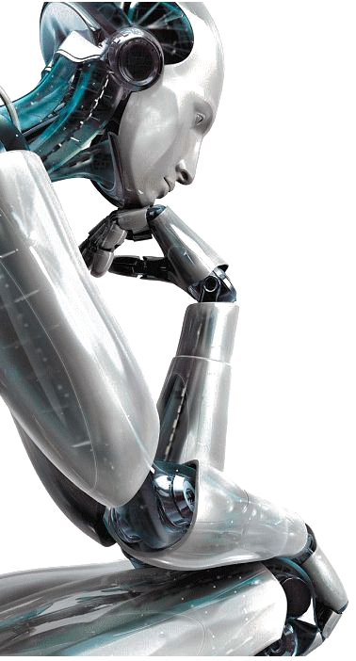
Admin
When the administrator accesses the system then he can manage all the data that are stored in the system such as:
Adding a new car
See all the cars
See the renter's information
Delete a car from the system.

Slide 9

Hardware
Software
Equipment Configuration:
Processor: Intel core/AMD
RAM: 2GB
Storage: 5/10 GB
Operating System: Window/Linux/Unix
Implementation Tools and Technology:
We are used GNU C++ Compiler and Codeblocks IDE.
We were complete this project in C++ Language.

Slide 10
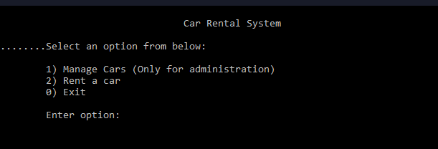

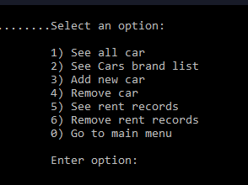
Design
Front page:

Slide 11
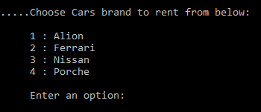
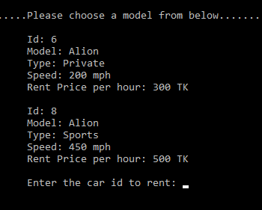
Design
User page:

Slide 12
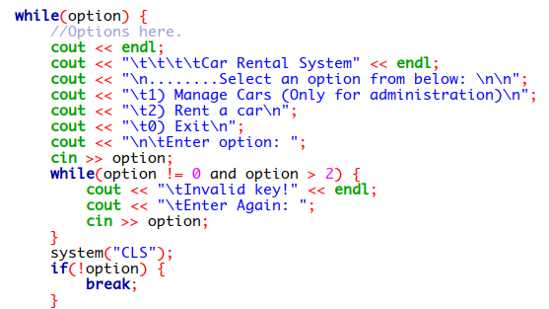
Implementation
Front page:

Slide 13
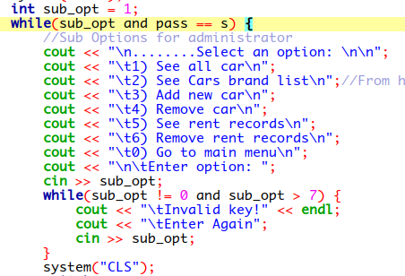
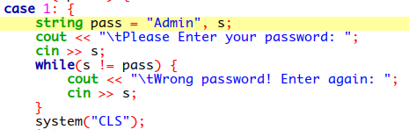
Implementation
Admin page:

Slide 14
Specification Feasibility
Our project has the ability to increase the features in future.
In which we have to embed.
GPS\GSM System
Advertisement of new models.
Sale point for vehicle.

Slide 15
Conclusion
A Console based software system for customers to search, view and reserve cars for renting And For businesses to manage and update the details and view business-related reports.

Slide 16
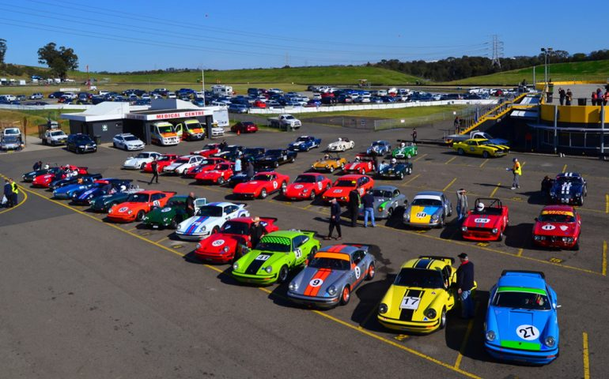
Thank You for your time!
Have a great day.

Slide 17
Do you have any query?

